Slide 1
Zoetrope Script FAQ
Hongjun Wu
2021.3.3

Slide 2
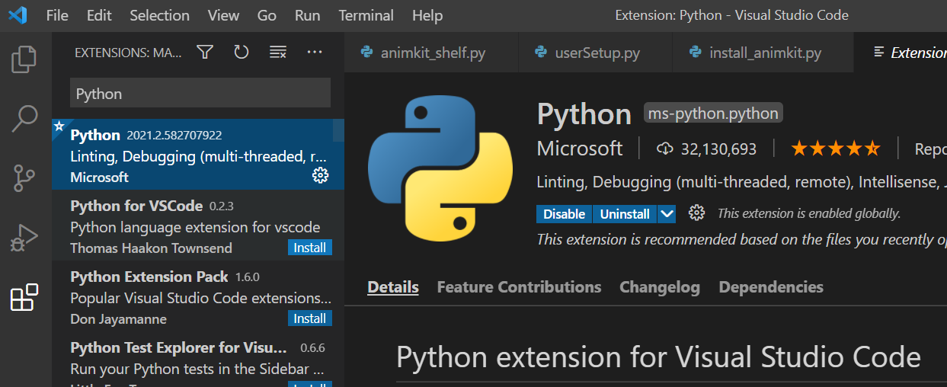

How to install AnimKit? (Windows)
Download the AnimKit package, Python, and VSCode.
Install Python plugin in VSCode by going to ↓ and install.
You should see a green play button on the right side of the window when you open install_animkit.py with VSCode (right click-open with VSCode)
Hit the play button.
You should see a log like this and AnimKit should be installed. Restart Maya to see if AnimKit shelf is there.

Slide 3
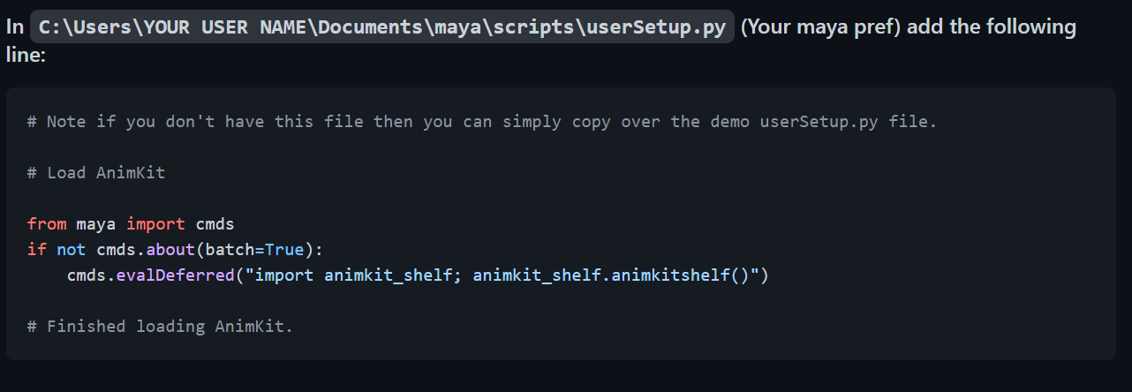
How to install AnimKit?,cont (Windows)
If you see this:
[⍻] [CHKDIR] WARNING: UserSetup file already exist at USER_SETUP , you may need to configure it manually.
Do this:

Slide 4

Zoetrope: Mechanics & Implementation
What:
Zoetrope is a substitute of Maya Batch Render when it doesn’t work.
When:
However, if Render Sequence works, you should use Render Sequence.
How:
Implementation of Zoetrope is achieved by calling Arnold Renderer to render one frame and loop over the timeline to avoid watermark caused by Batch Render checking the licensing server every time it renders a frame.

Slide 5
Zoetrope: Pro and Con
Pro:
Much more reliable than Maya Batch (Different from Maya Batch, it does not check the Arnold licensing server every time it renders a frame).
Con:
There is no good way to stop it once it is started unless you go into task manager (ctrl + alt + del) and kill the Maya process.
Unlike Render Sequence, no renderview (Expected).
Cannot dedicate to a certain render path (Overrides project path), default to shot_folder/renders/defaultRenderLayer, and needs manual copying renders to a storage location. (This is due to I just want something that works asap and a quick + ez solution lol)
Cannot render alpha channel. (Hasn’t find a way around yet)

Slide 6
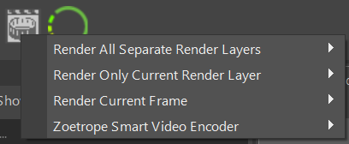

Zoetrope: Main Menu
Render All Separate Render Layers
To shot_folder/renders/layer
I don’t use it much, so idk if it works well or not
Render Only Current Render Layer
To shot_folder/renders/defaultRenderLayer
Mostly used to render masterlayer (Dazzle is mostly masterlayer)
Tried and trusted!
Render Current Frame
Render the current frame on timeline to desired format (.png or .tif).
Perfect for frame render test or re-render a broken frame.
In development & not working ↑

Slide 7
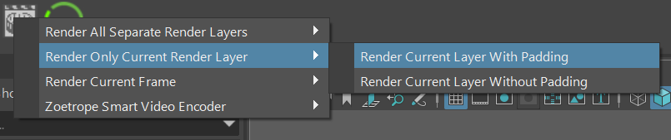
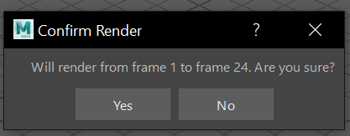
Zoetrope: Submenu
How to control render range? Adjust the timeline! Easy like that.
Overrides render settings.
Vocab: “Padding”
With Padding: The entire timeline (aka the two outter number on the timeline, both light grey and dark grey portion, -24 to 48)
Without Padding: Only the light grey portion (aka the two inner frame numbers, 1 to 24)
Still confused? No worries, Zoetrope will ask you before it starts working.
Example Timeline:

